Slide 1
Full-Stack Information Extraction System for Cybersecurity Intelligence
Youngja Park, Taesung Lee
2022 Conference on Empirical Methods in Natural Language Processing(EMNLP)

Slide 2
Goal
Developed an Information Extraction(IE) System SecIE that can extract large number of cybersecurity-related entities, relations, and the temporal information of the relations.
The IE System can be applied to various Security downstream task.
Notes:
設計一個Information Extraction System SecIE, 這個IE system專門針對資安領域，能夠抓出資安報告裡面的entities, relations 和 relation發生的時間。作者團隊希望這個SecIE能夠被運用在不同的downstream task上面。

Slide 3
Challenges
CTI reports often contain overwhelming information(and has no fixed format).
Learning-based method (supervised) relies on a large amount of high-quality labeled data which is difficult to acquire in security domain.
Notes:
第一點就是CTI report或是其它資安文件通常篇幅很長，十幾頁裡面只有幾段重點，而且沒有固定的格式。
再來是比較難應用learning-based 的方式在資安領域上，supervised learning 需要大量且高品質的data。而標注資安的data需要大量的背景知識，加上第一點，讓labeling變的非常麻煩。

Slide 4
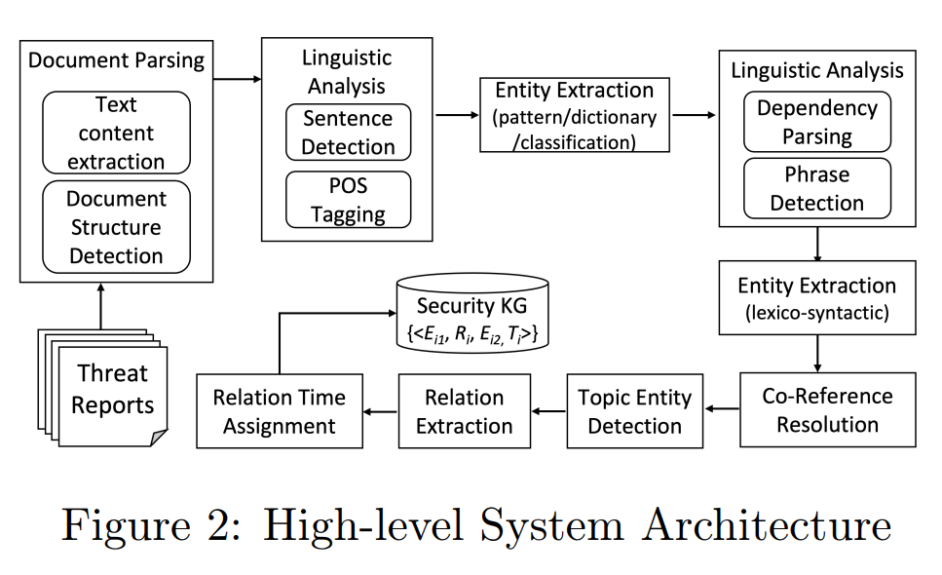
Method Overview
Notes:
Linguistic Analysis 分成兩階段，因為作者有小小改良第二階段的Dependency parsing，結合entity跟dependency parsing來提高正確性。

Slide 5

Document Parsing
Utilizing ${\text{Apache} \text{Tika}}^{[1]}$ to extract text content and document structure such as titles, tables, hyperlinks and list structure.
Apache Tika is a toolkit used to detect and extract metadata and text from different file types including PPT, XLS, PDF.
Notes:
用現成的package Apache Tika 擷取文件中的文字還有文件的metadata，像是作者、標題、超連結等等

Slide 6
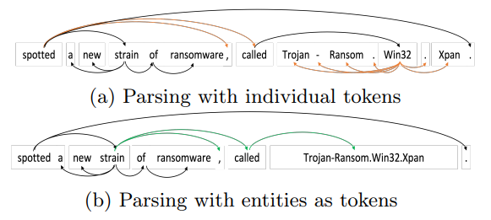
Linguistic Analysis
Performing sentence boundary detection, part-of-speech(POS) and dependency parsing.
Notes:
切出句子，做part-of-speech。 Part-of-speech用來找出每個文字在句子中的詞性，例如名詞或動詞。 Dependency parsing找出句子中各個文字之間的關係。因為很多資安領域的名詞長的很奇特，像是這個trojan-Ransom.win32.xpan一般會被切成三句，因為有三個逗號。但是這樣的切法會讓dependency parsing的正確性下降，所以作者先做entity Extraction，然後以entity為單位做dependency parsing。

Slide 7
Entity Extraction
Consisting of 3 part:
Pattern-based
Dictionary-based, Lexico-Syntactic Pattern-based
Classification-based

Slide 8
Entity Extraction - Pattern-based
Used for entity types with well-defined patterns such as IP Address or Email Address.
Also support many IOC patterns such as:
X.Y.177.245
82(dot)103(dot)137(dot)14
BLOCKED.BLOCKED.172.196
x0x0.[REMOVED].com.br

Slide 9
Entity Extraction - Dictionary-based
Used for reputable entities such as Malware that are well-documented.
Only effective to previously known samples.
Using the Lexico-Syntactic pattern matching method to extract new mentions.

Slide 10
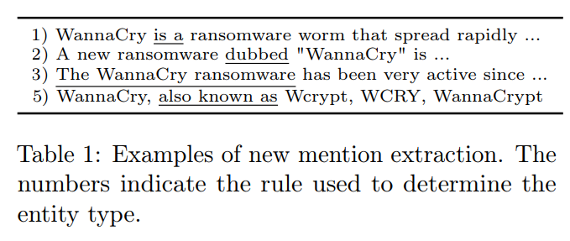
Entity Extraction - Lexico-Syntactic pattern
Applying following syntactic pattern to extract new mentions
NP (, NP)* BE NP
NP, CALLED NP
NP such as NP (, NP)*
NP including NP (, NP)*
NP a.k.a | ((which|that)? (BE)? (also)? CALLED as) NP
NP refers to “noun phrase”
CALLED refers to “called”, “named”…

Slide 11
Entity Extraction – Classification-based
Regex-based method does not apply to certain examples such as ‘ADWARE/Agent.imv’ or ‘Trojan-Ransom.Win32.Xpan’ and such examples appears frequently in CTI report.
Train a Logistic-Regression model to classify entities.

Slide 12
Co-reference Resolution
Consisting of 2 part:
Within-sentence
Cross-sentence

Slide 13
Co-reference Resolution - Within-sentence
Pattern-based approach, for example:
“<nominative noun> [,] CALLED [as] <proper noun>”
“a new strain of ransomware, called Trojan-Ransom.Win32.Xpan”:
a new strain of ransomware ↔ Trojan-Ransom.Win32.Xpan
“a gang called TeamXRat”: a gang ↔ TeamXRat

Slide 14
Co-reference Resolution - Cross-sentence
Utilizing a document structure-based sentence embedding model which generates semantic representations for sentences using BERT.
If a sentence contains a nominative or pronoun mention (e.g., ‘the malware’), identity semantically related sentence and find its referent from those sentences.

Slide 15
Topic Entity Detection
Topic Entity – The focus of a CTI report, such as particular malware or campaign (CTI report perform deep analysis on the topic entity)
Rule-based method to detect Topic Entity

Slide 16
Relation Extraction
OpenIE Relation Extracion
Detect relation from certain syntactic structures such as : “NP(subj)-VP-NP(obj)”
Relation: VP
Coocuurence-based Relation Extraction
When two or more entities co-occur in the same sentence, assign relation between them.
Relation: related
Relations with Topic Entity
If entities are not included in any relations, connect them with topic entity.
Relation: related + entity type

Slide 17
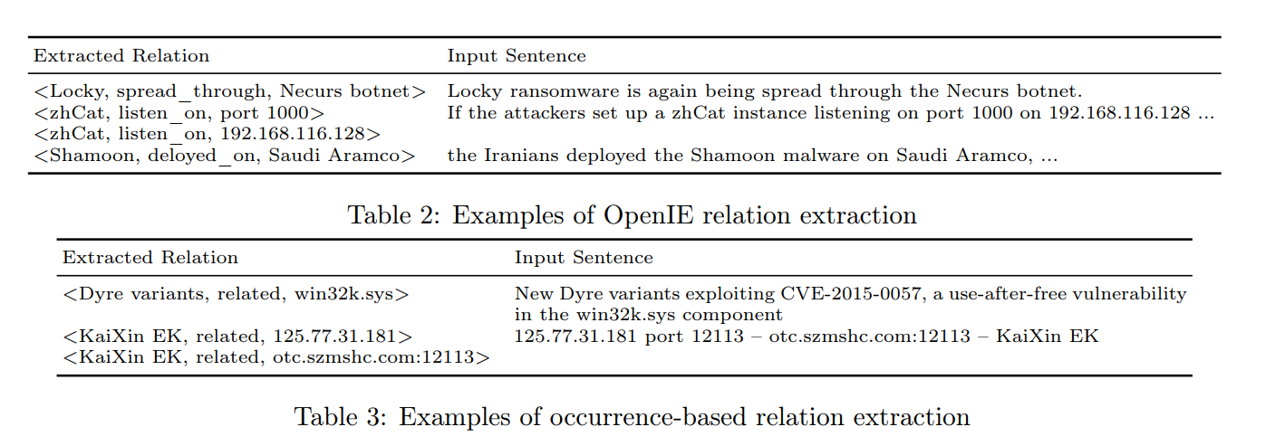
Relation Extraction

Slide 18
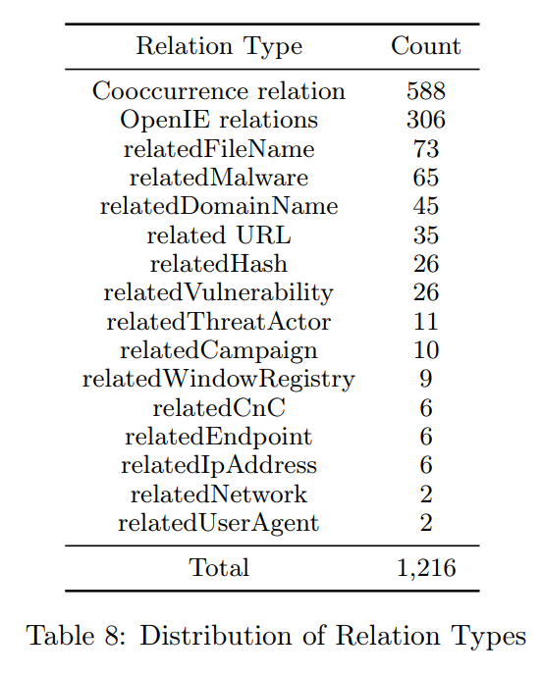
Relation Extraction

Slide 19
Temporal Information Extraction
Assign each relation a temporal information based on following priority:
Time in the same dependency construct
Time in the same sentence
Time in the previous sentence
The document’s last modified time
The document’s published time

Slide 20
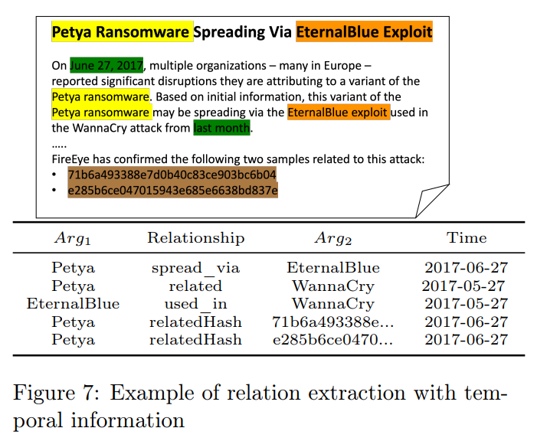
Temporal Information Extraction

Slide 21
Evaluation
Entity Extraction
Relation Extraction
Dataset
133 labeled document containing 3295 entities and 1216 relation mentions

Slide 22
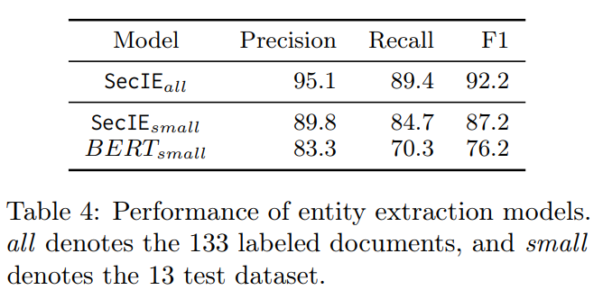



Evaluation – Entity Extraction
$$Precision=\frac{TP}{(TP+FP)}$$
$$Recall=\frac{TP}{(TP+FN)}$$
$$F1−Score=\frac{2∗Precision∗Recall}{(Precision+Recall)}$$

Slide 23
Evaluation – Relation Extraction
Entity span, Entity type
Relation type

Slide 24
Relation Extraction

Slide 25
Evaluation – Relation Extraction
 | Entity Spans | Entity types | Relation type
ExactMatch | V | V | V
-eType | V |  | V
-rType | V | V
-eType-rType | V

Slide 26
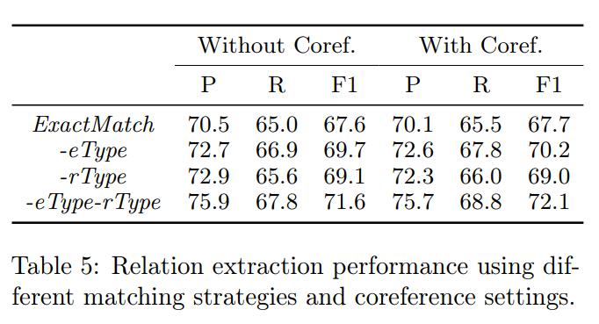
Evaluation – Relation Extraction
$$Precision=\frac{TP}{(TP+FP)}$$
$$Recall=\frac{TP}{(TP+FN)}$$
$$F1−Score=\frac{2∗Precision∗Recall}{(Precision+Recall)}$$

Slide 27
Application
Transform relations in to Knowledge Graph.

Slide 28
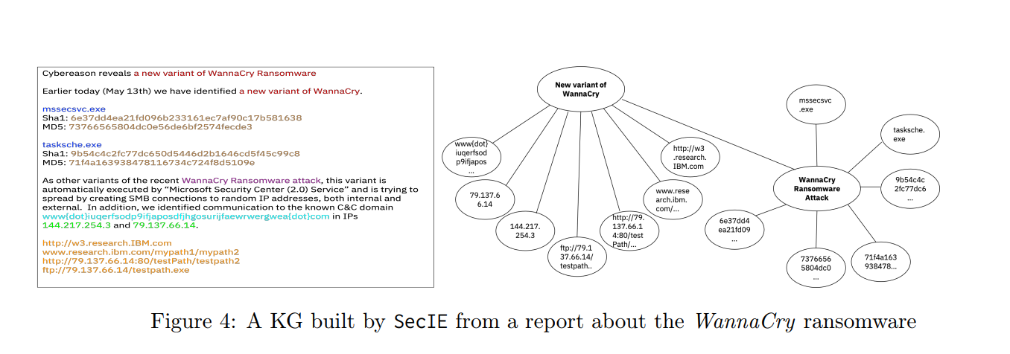
Application

